Slide 1
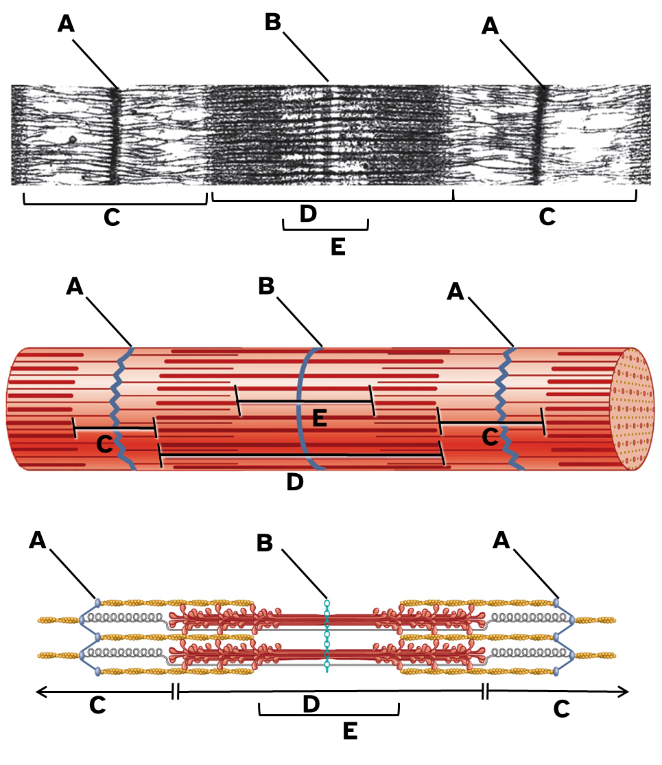
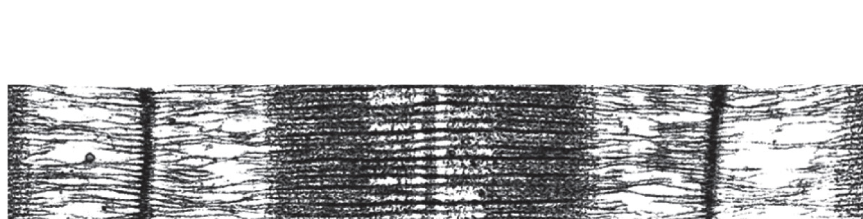
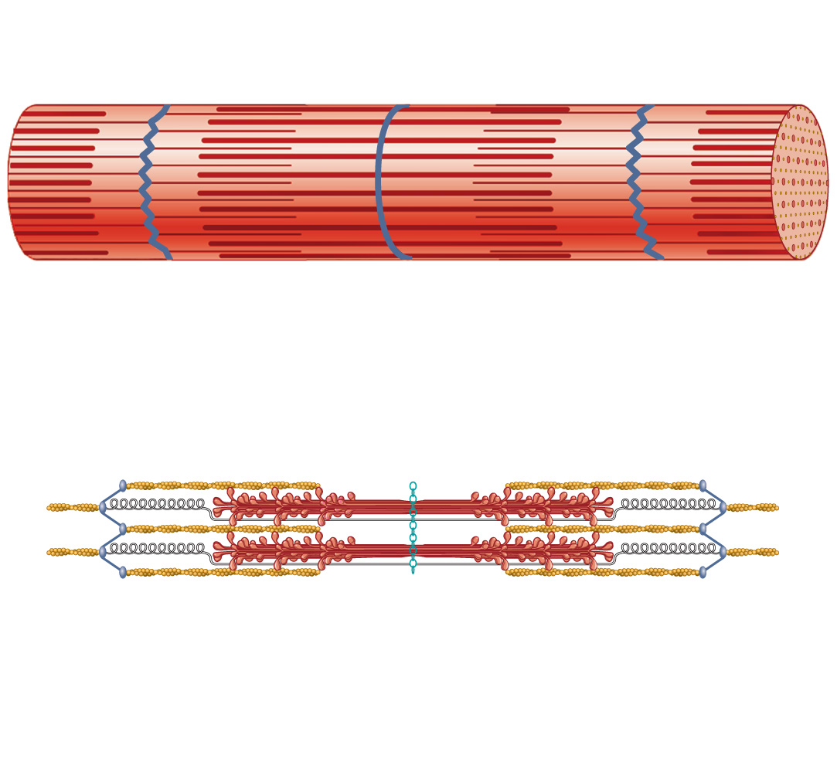
A
B
A
C
D
C
E
A
B
A
E
C
C
D
A
B
A
C
D
C
E

Slide 2
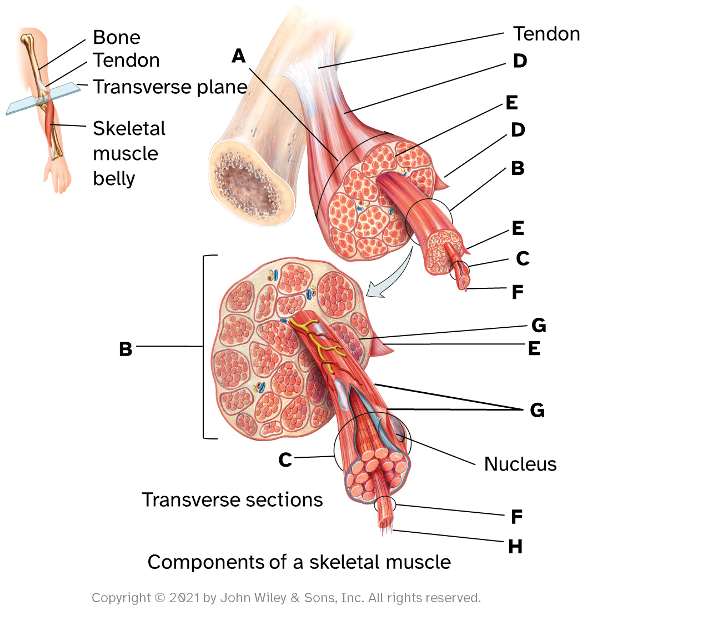
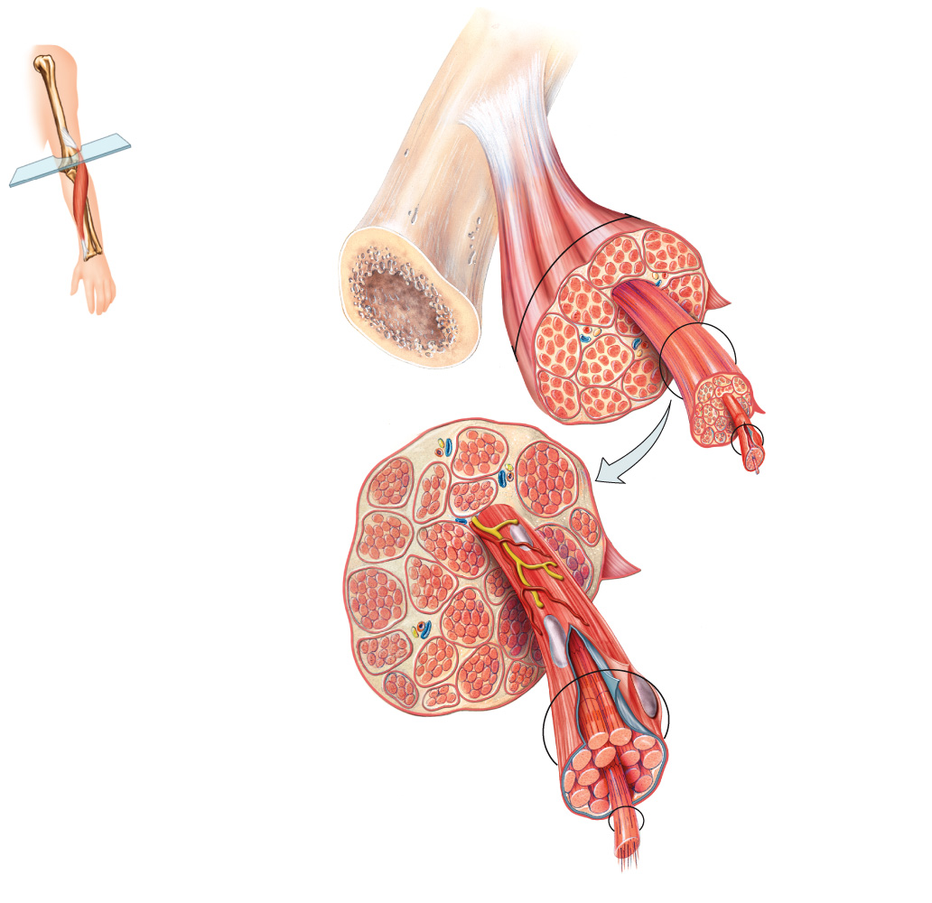
Bone
Tendon
Tendon
A
D
Transverse plane
E
Skeletal muscle belly
D
B
E
C
F
G
B
E
G
C
Nucleus
Transverse sections
F
H
Components of a skeletal muscle

Slide 3
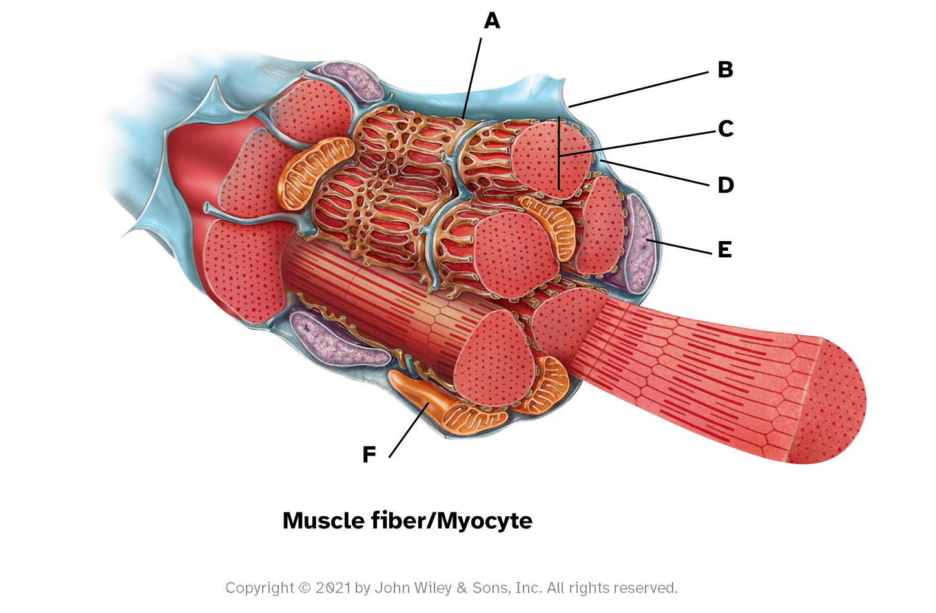
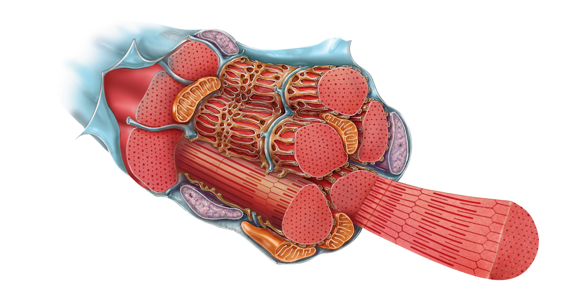
A
B
C
D
E
F
Muscle fiber/Myocyte

Slide 4
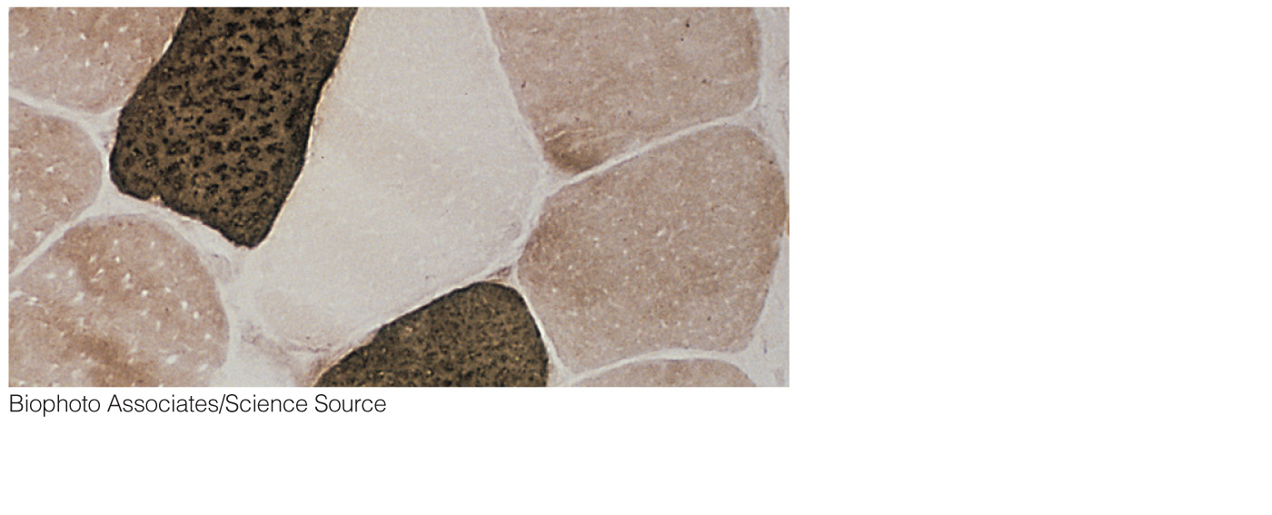
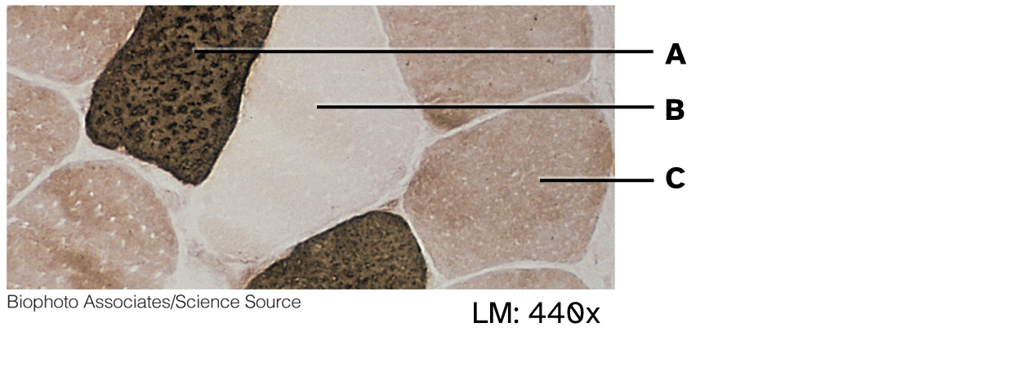
A
B
C
LM: 440x

Slide 5
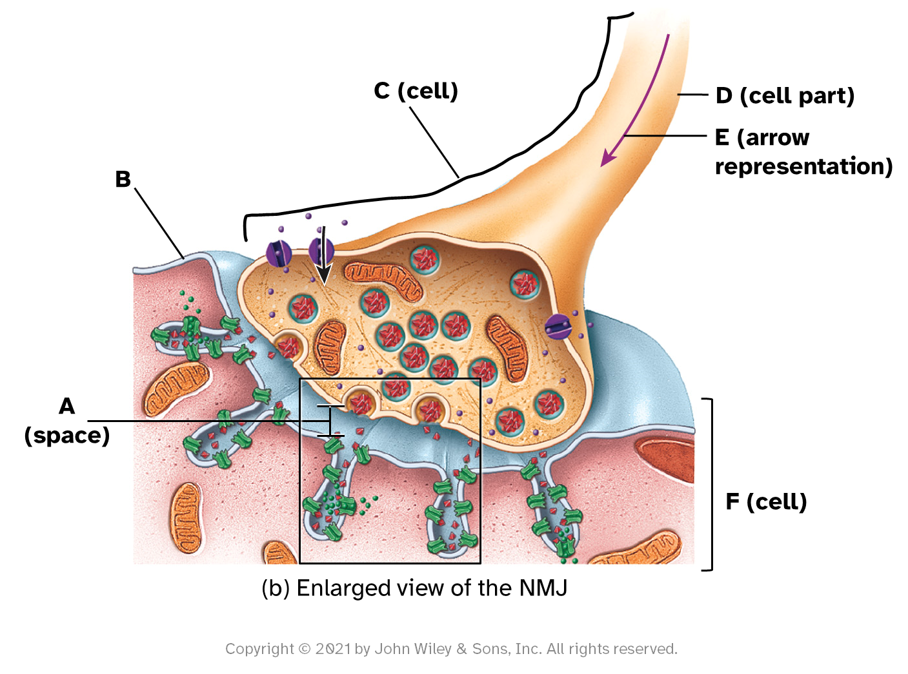
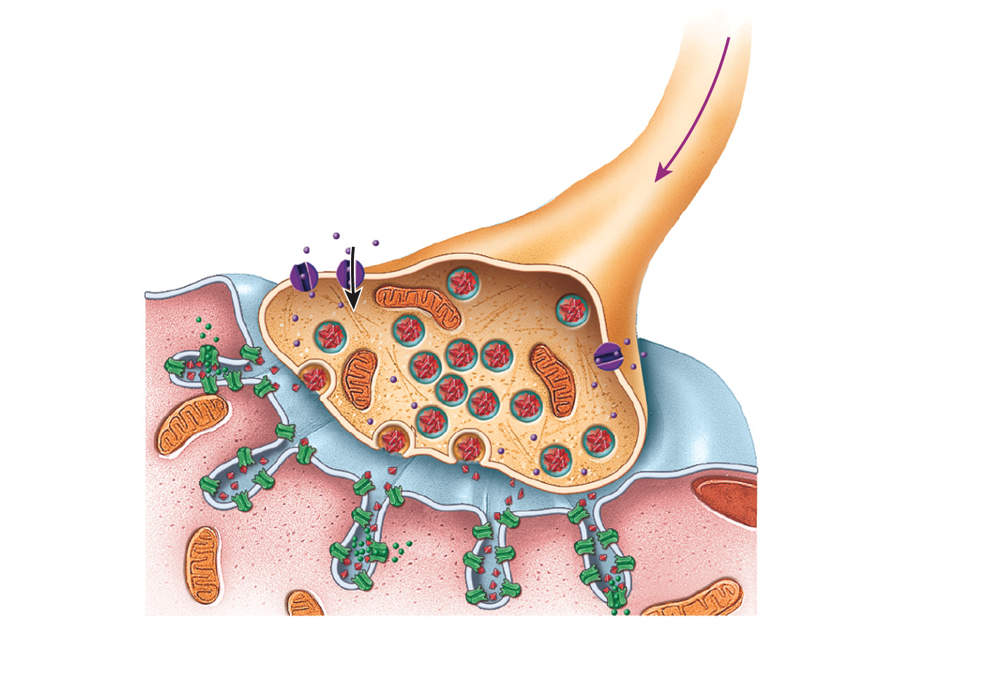
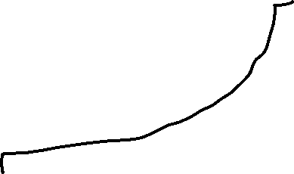
C (cell)
D (cell part)
E (arrow representation)
B
A (space)
F (cell)
(b) Enlarged view of the NMJ

Slide 6
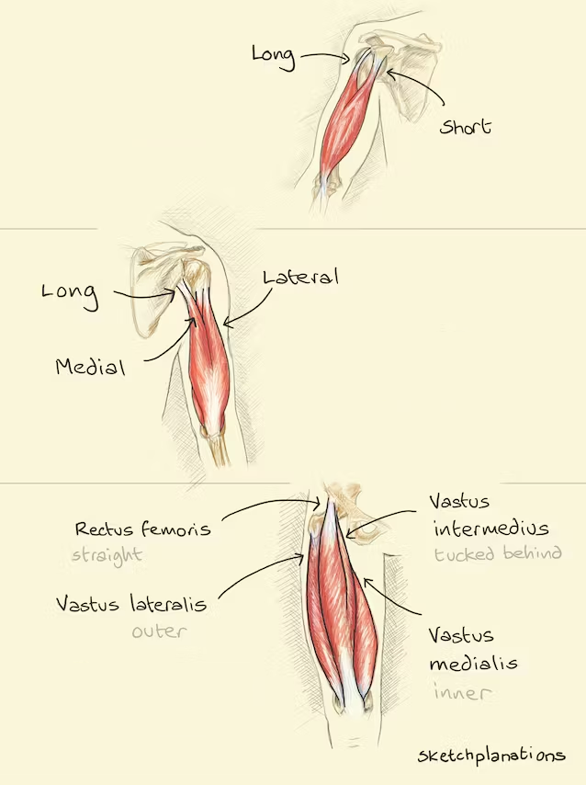
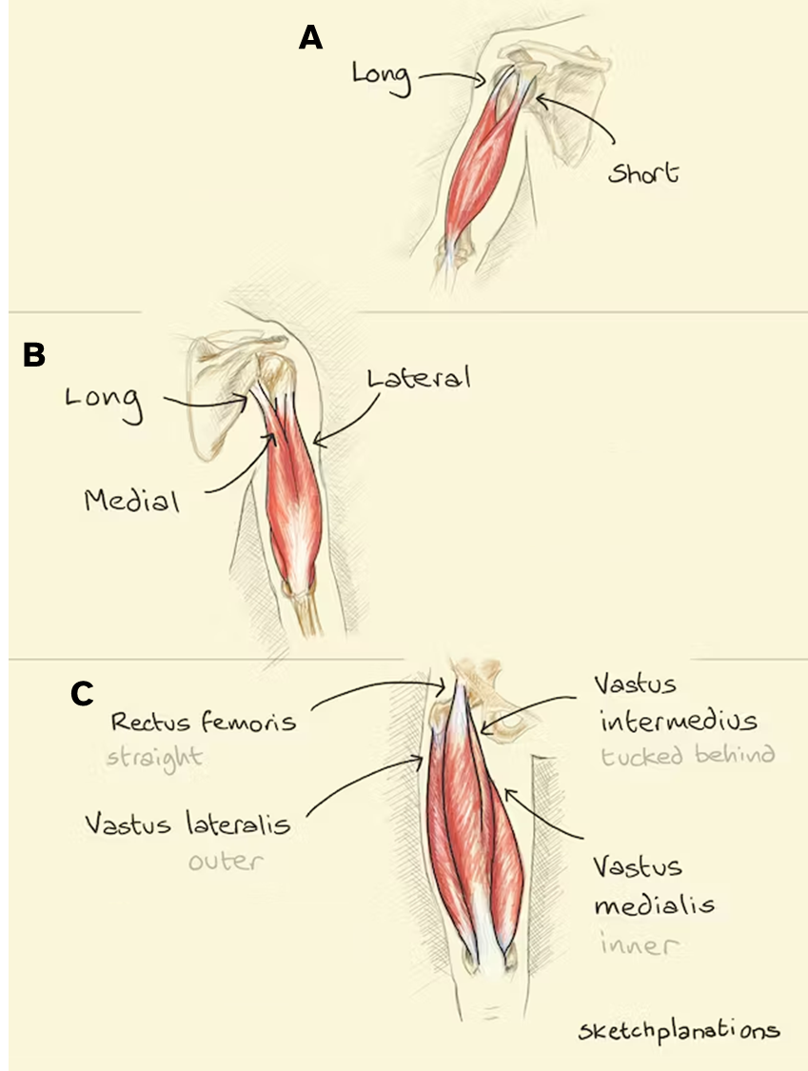
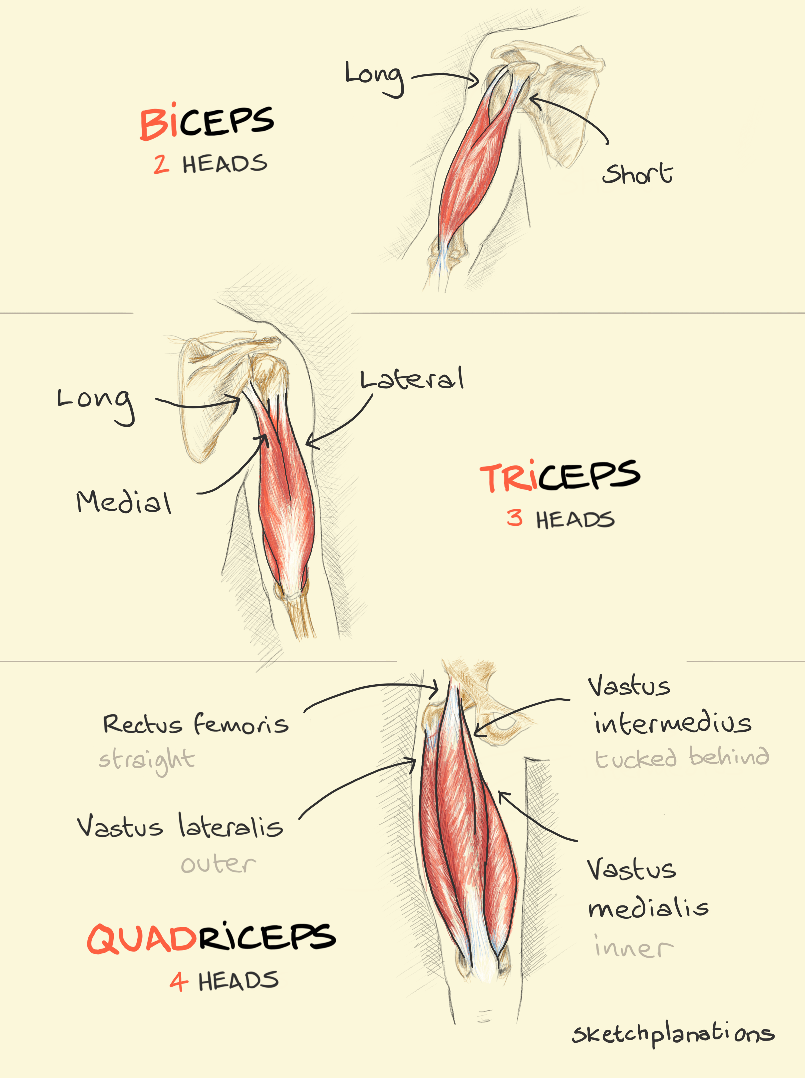
A
B
C
Notes:
https://sketchplanations.com/biceps-triceps-quadriceps

Slide 7
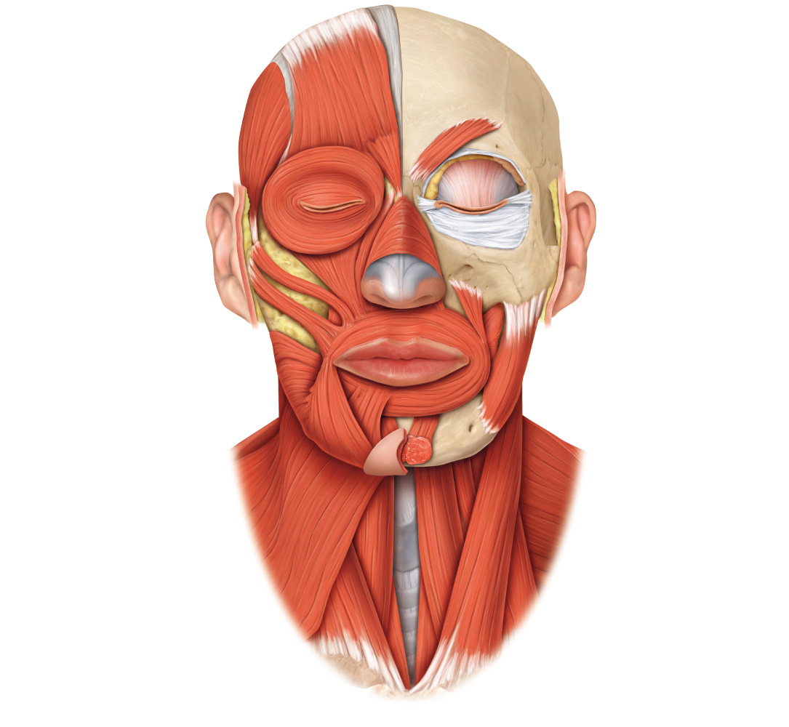
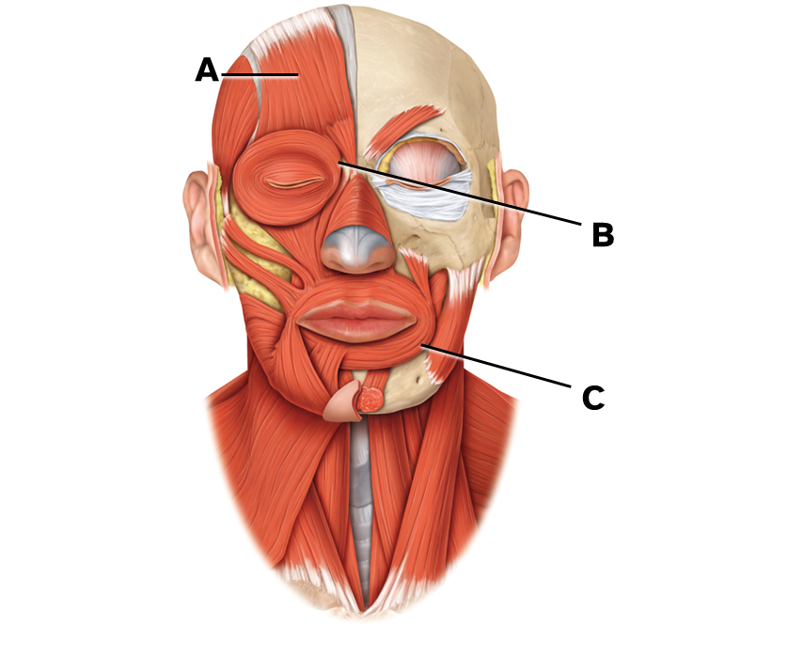
A
B
C

Slide 8
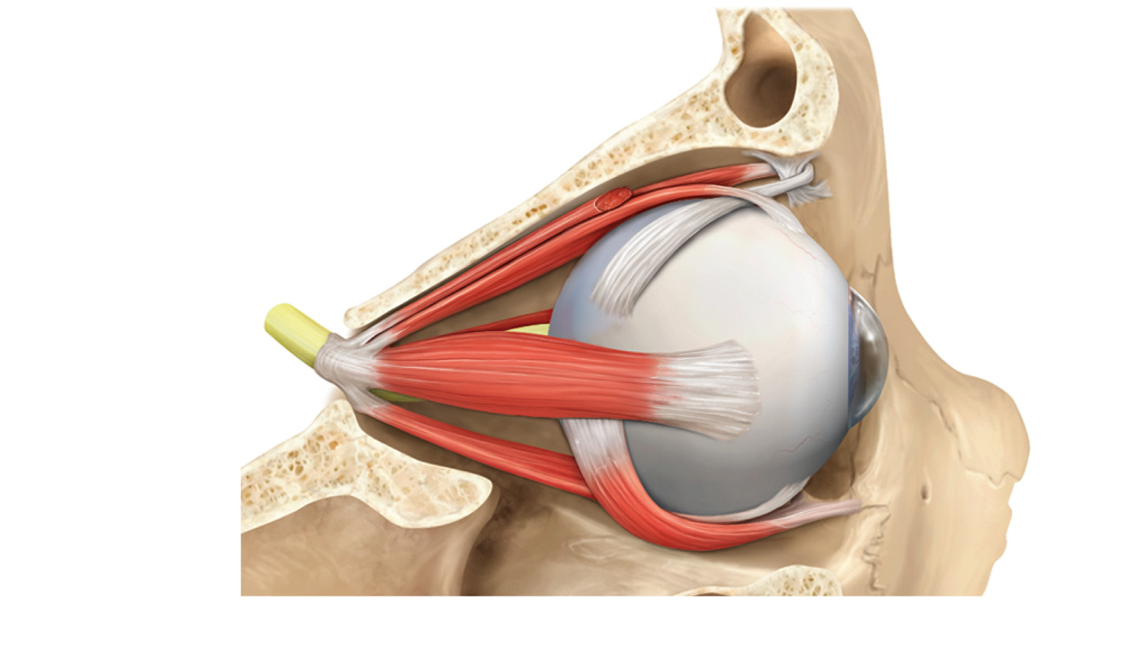
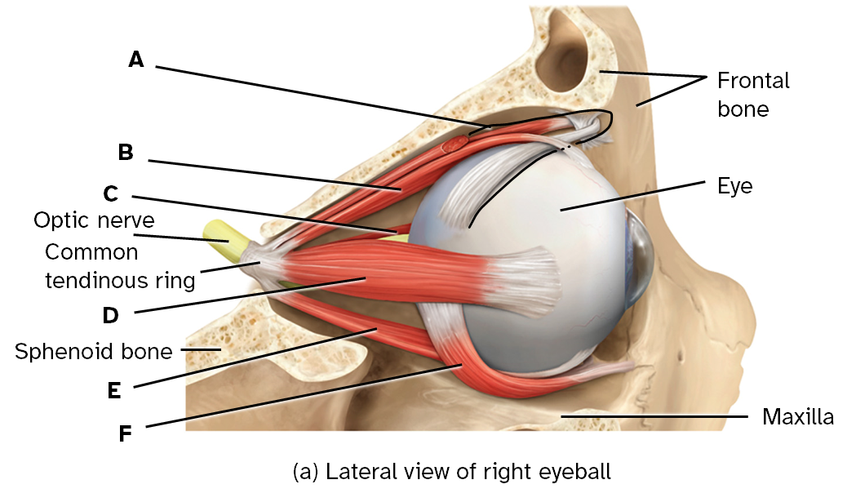
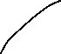
A
Frontal
bone
B
C
Eye
Optic nerve
Common tendinous ring
D
Sphenoid bone
E
F
Maxilla
(a) Lateral view of right eyeball

Slide 9
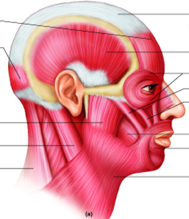
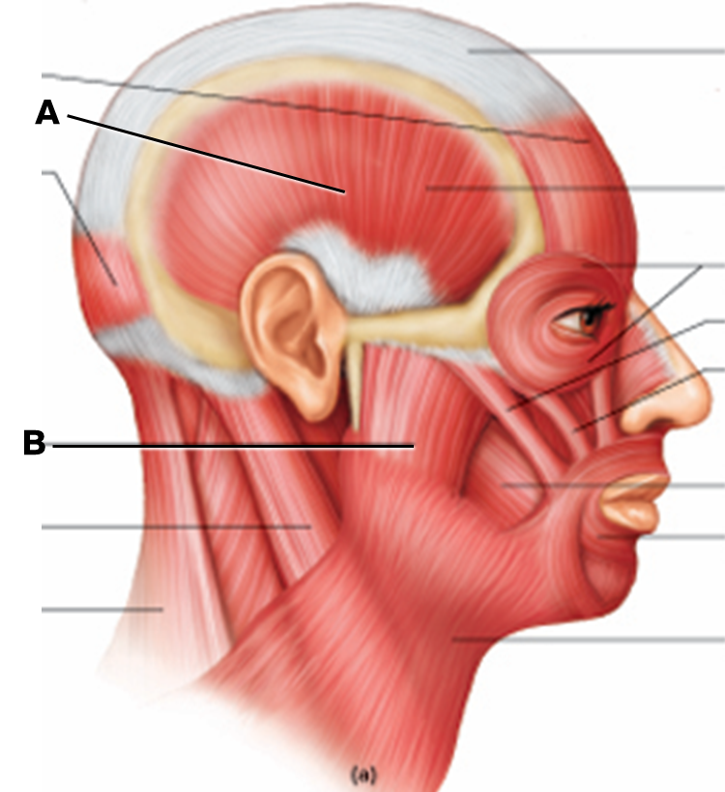
A
B

Slide 10
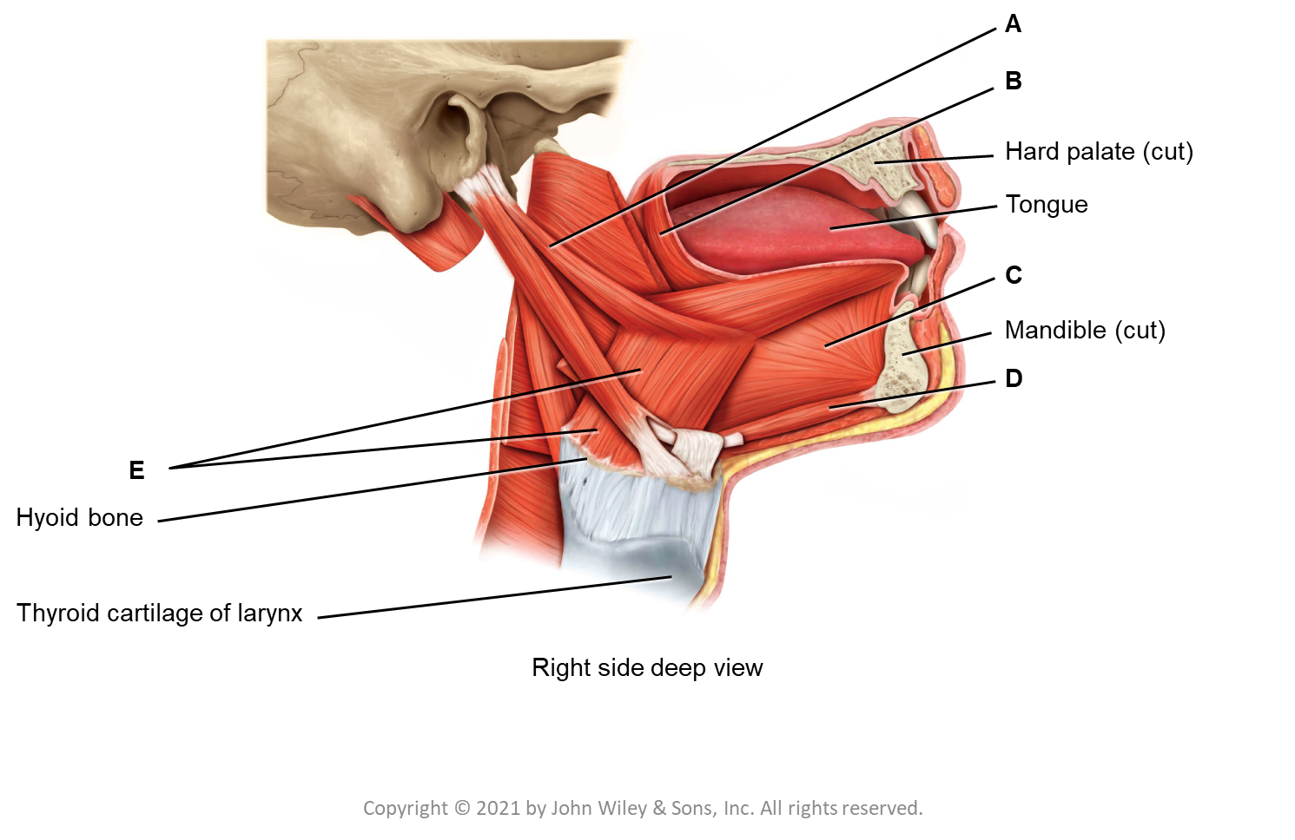
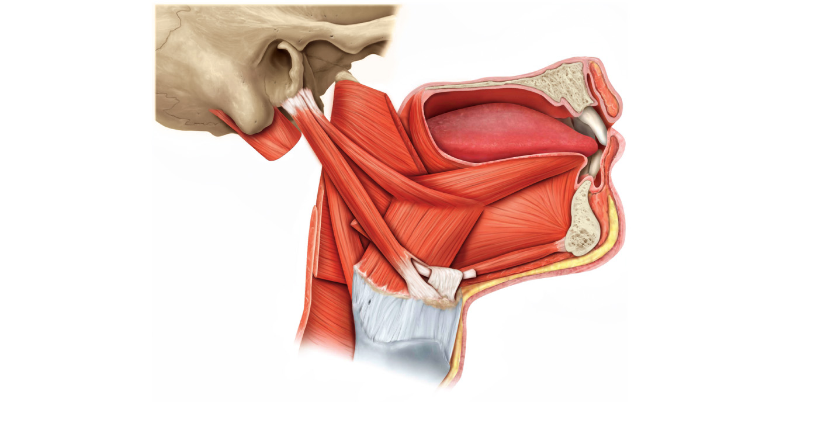
A
B
Hard palate (cut)
Tongue
C
Mandible (cut)
D
E
Hyoid bone
Thyroid cartilage of larynx
Right side deep view

Slide 11
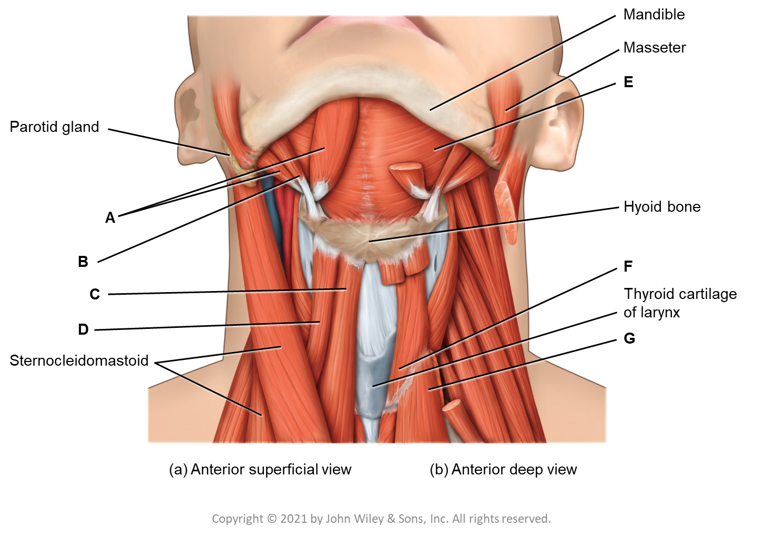
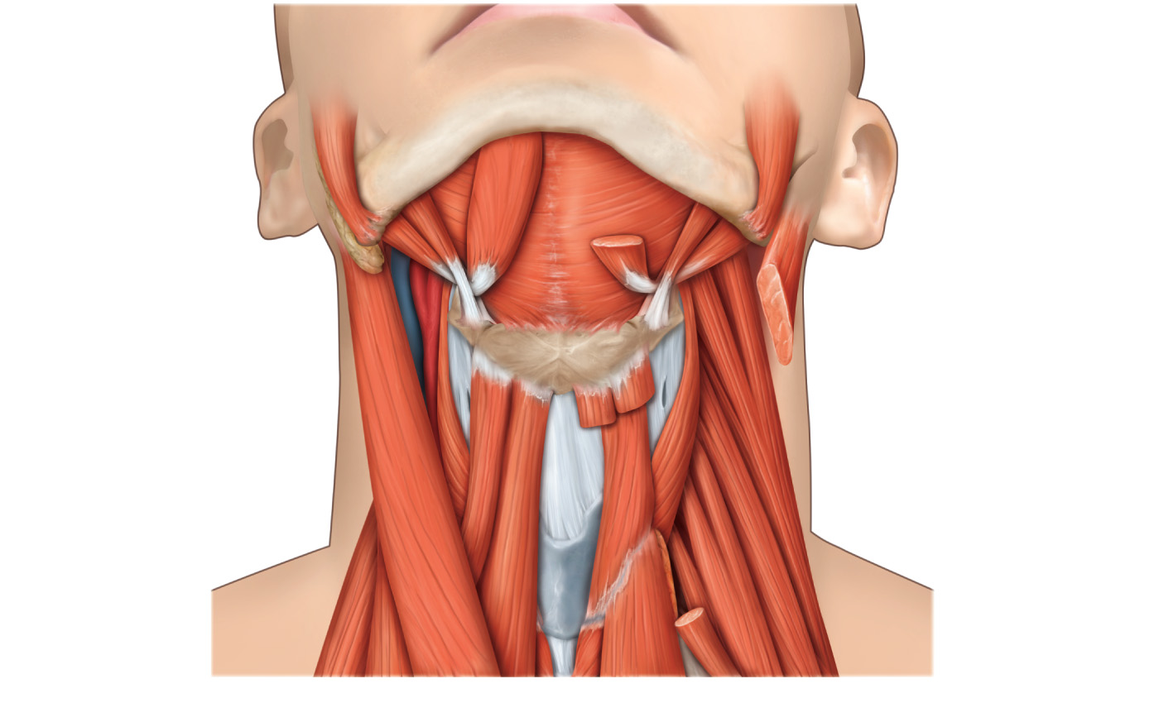
Mandible
Masseter
E
Parotid gland
A
Hyoid bone
B
F
C
Thyroid cartilage
of larynx
D
G
Sternocleidomastoid
(a) Anterior superficial view
(b) Anterior deep view

Slide 12
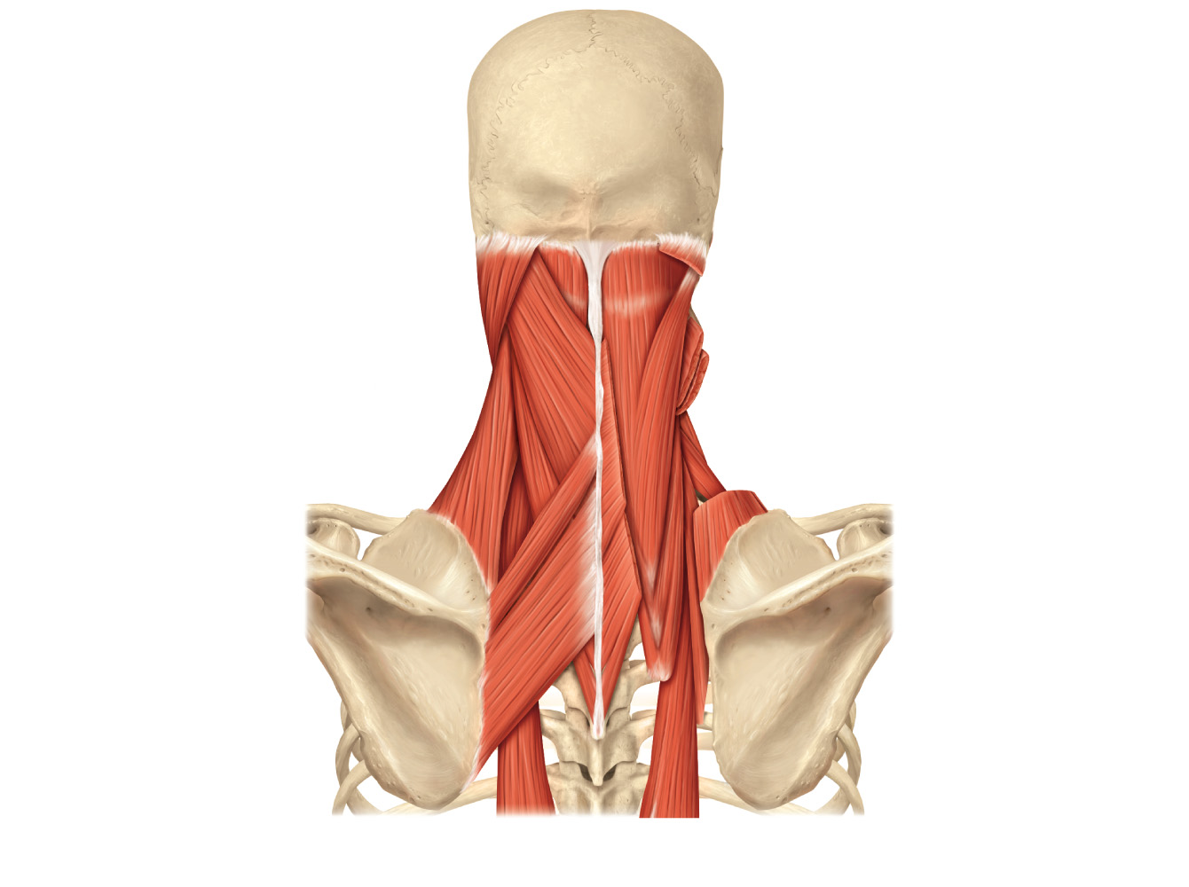
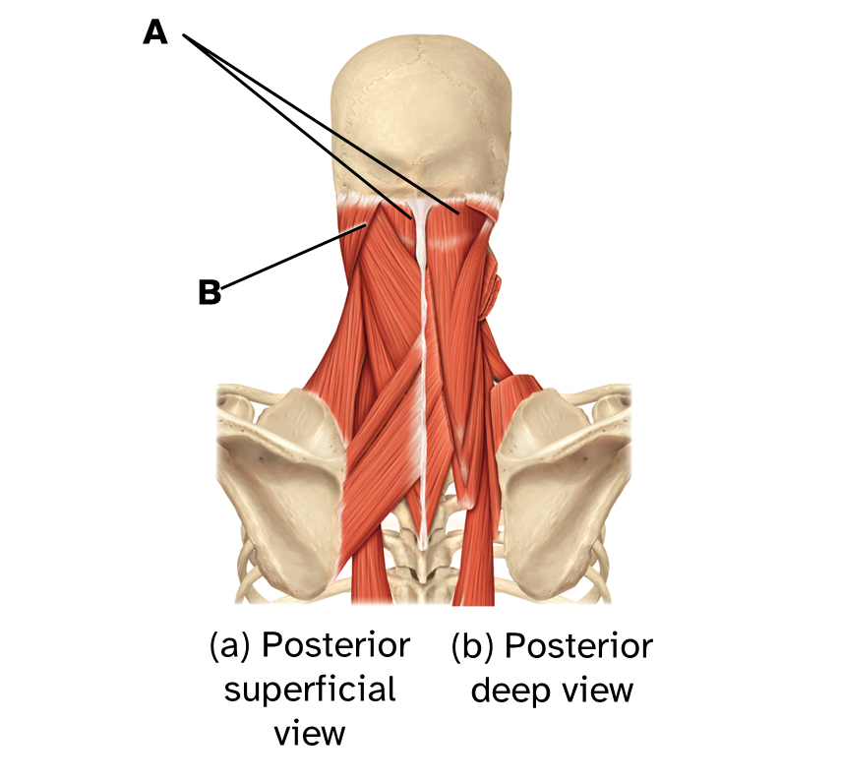
A
B
(a) Posterior superficial view
(b) Posterior deep view

Slide 13
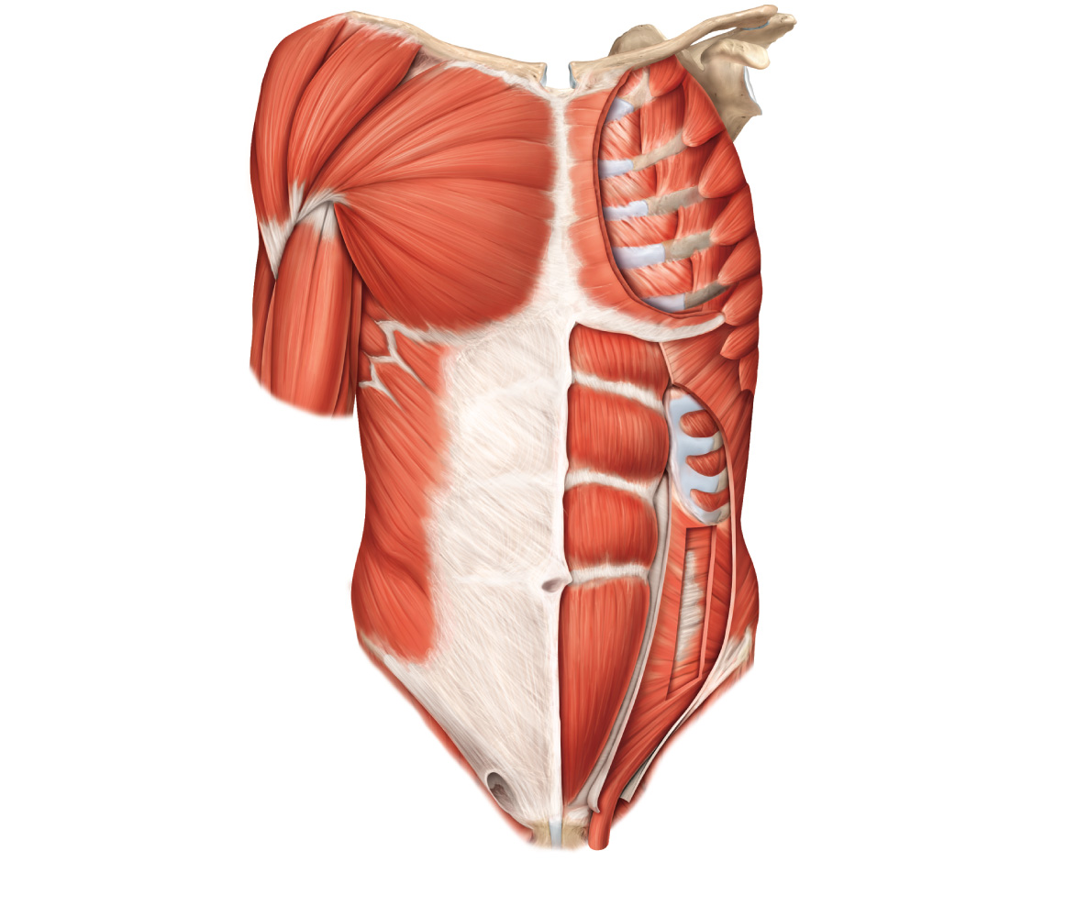
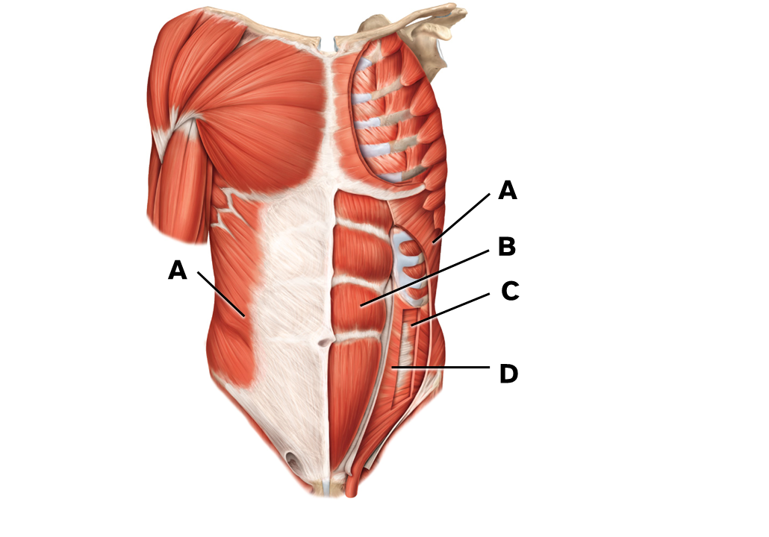
A
B
A
C
D

Slide 14
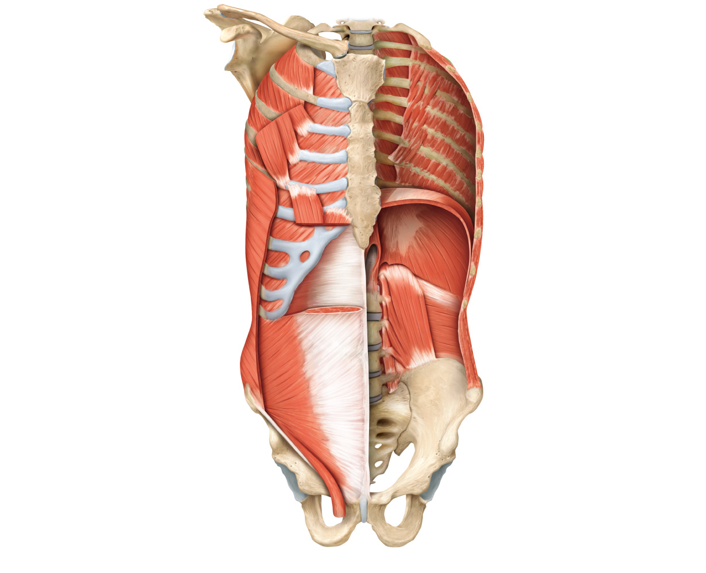
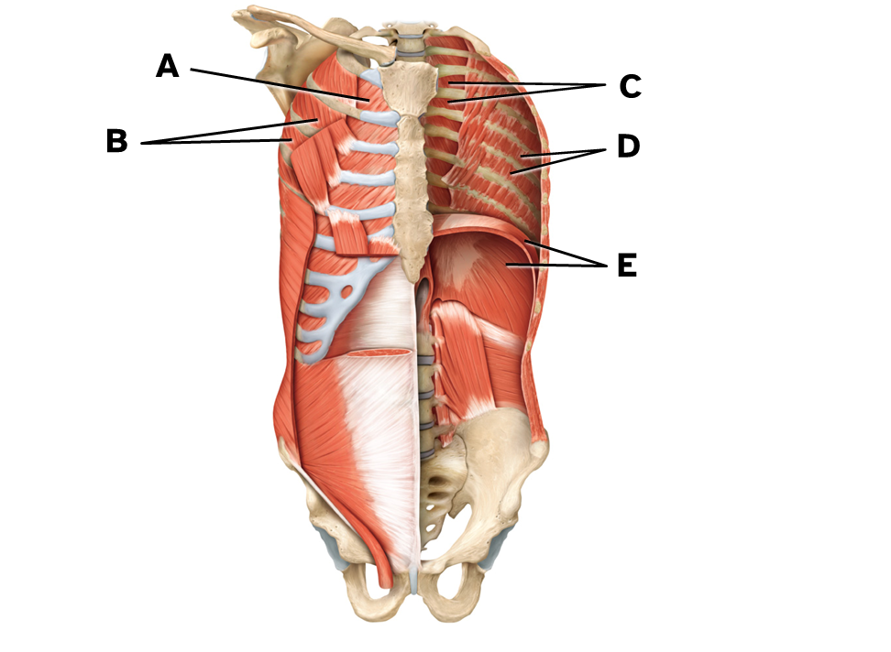
A
C
B
D
E

Slide 15
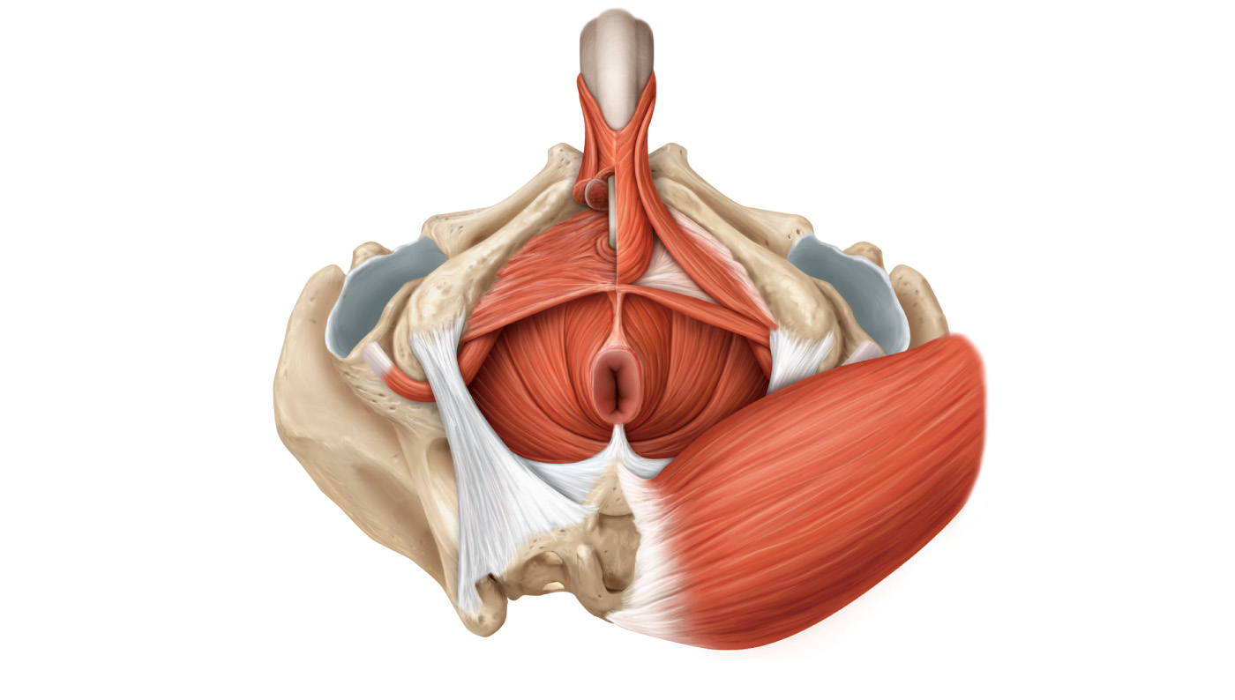
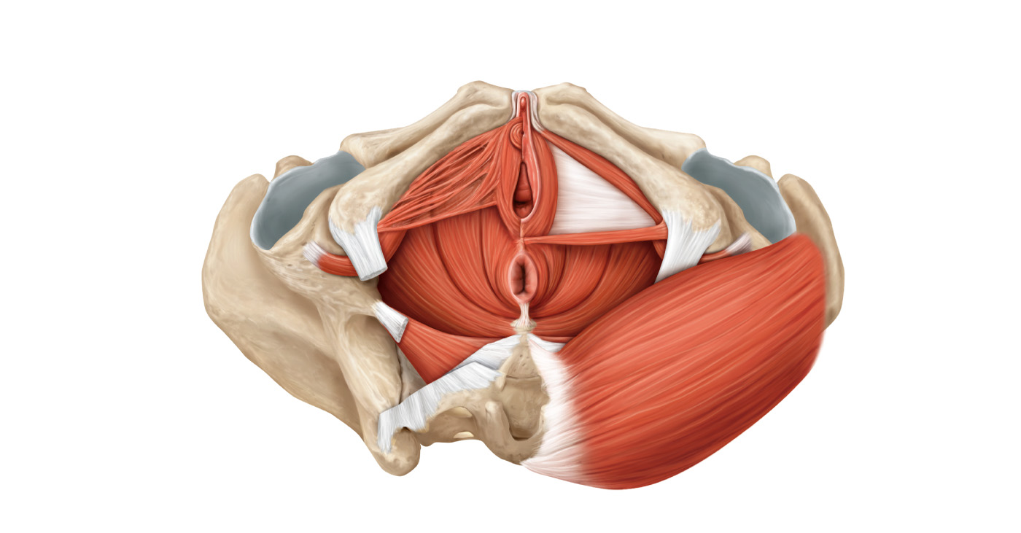
Anus
A
Inferior superficial view of male perineum
Anus
A
Inferior superficial view of a female perineum

Slide 16
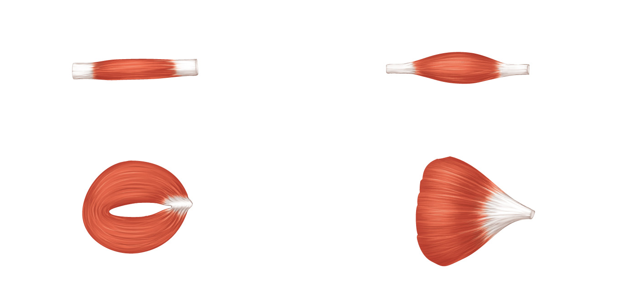
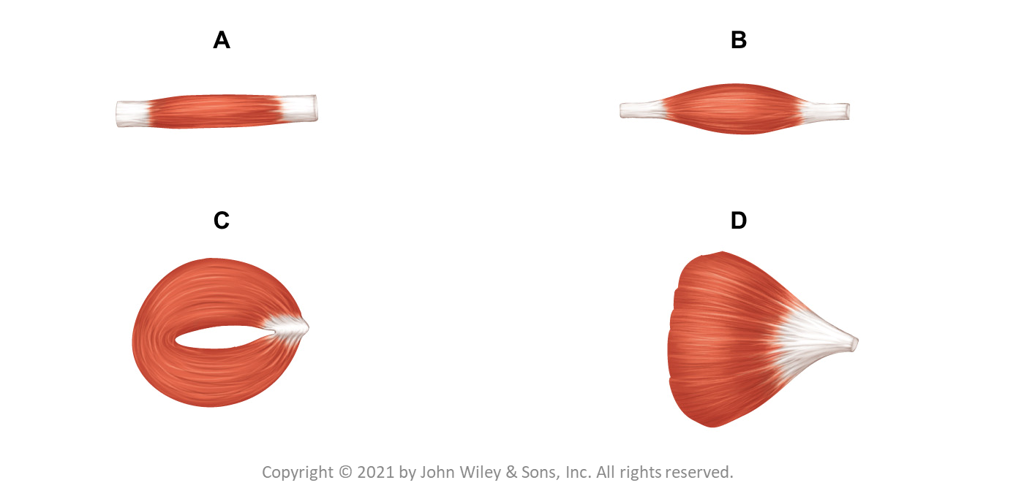
A
B
C
D

Slide 17
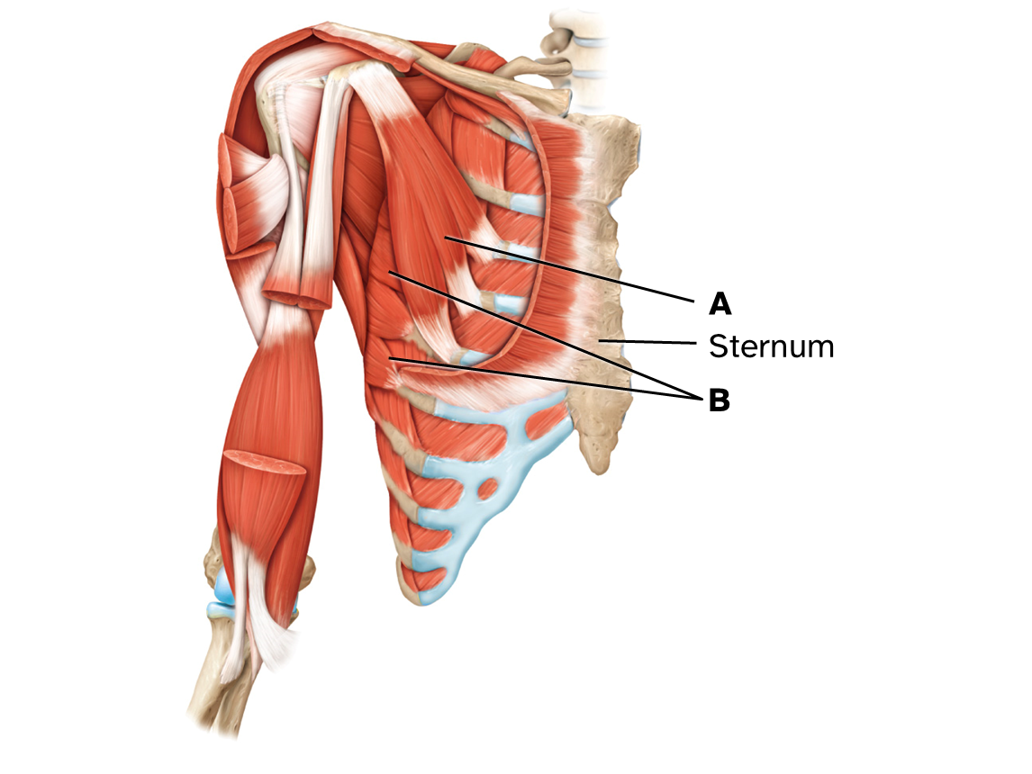
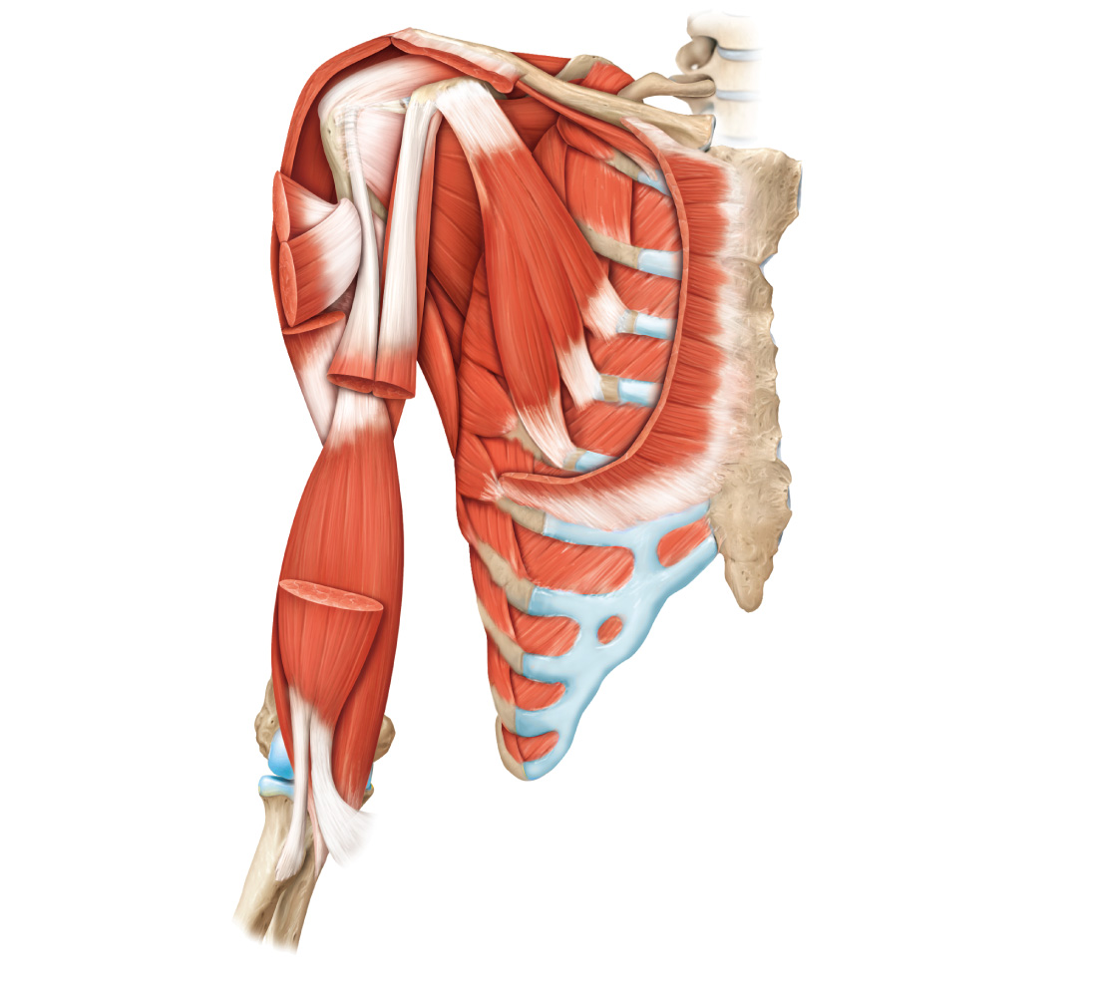
A
Sternum
B

Slide 18
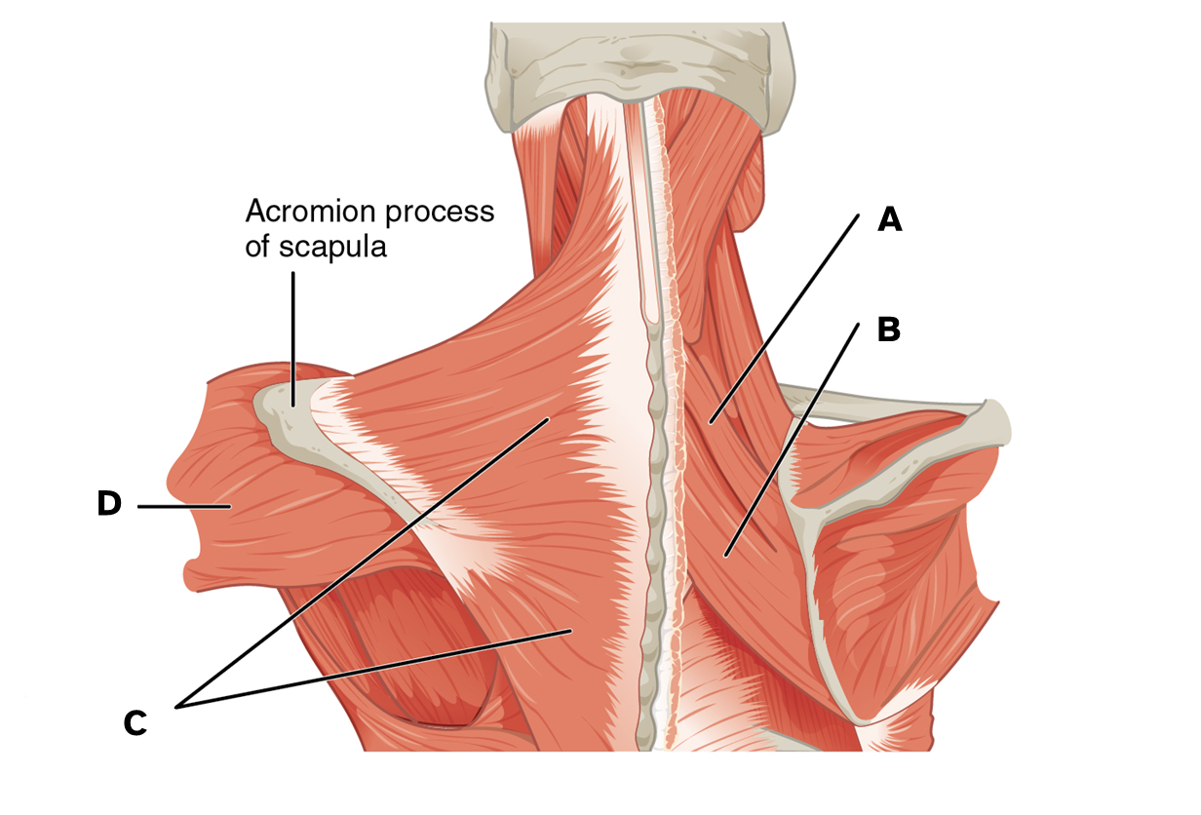
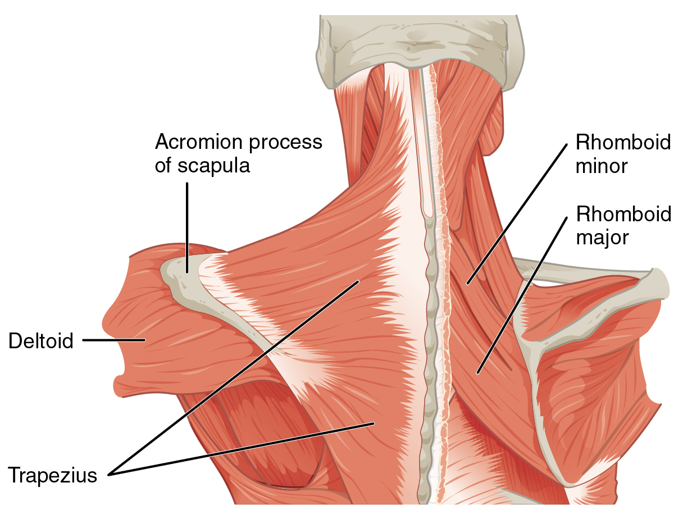
A
B
D
C

Slide 19
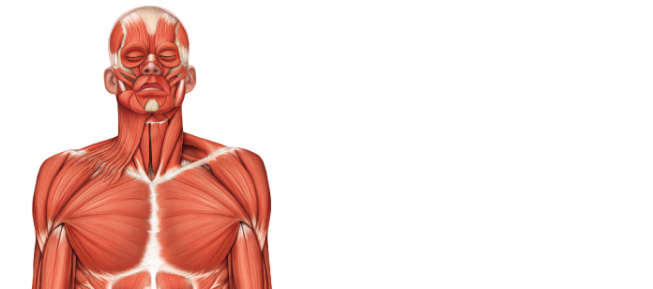
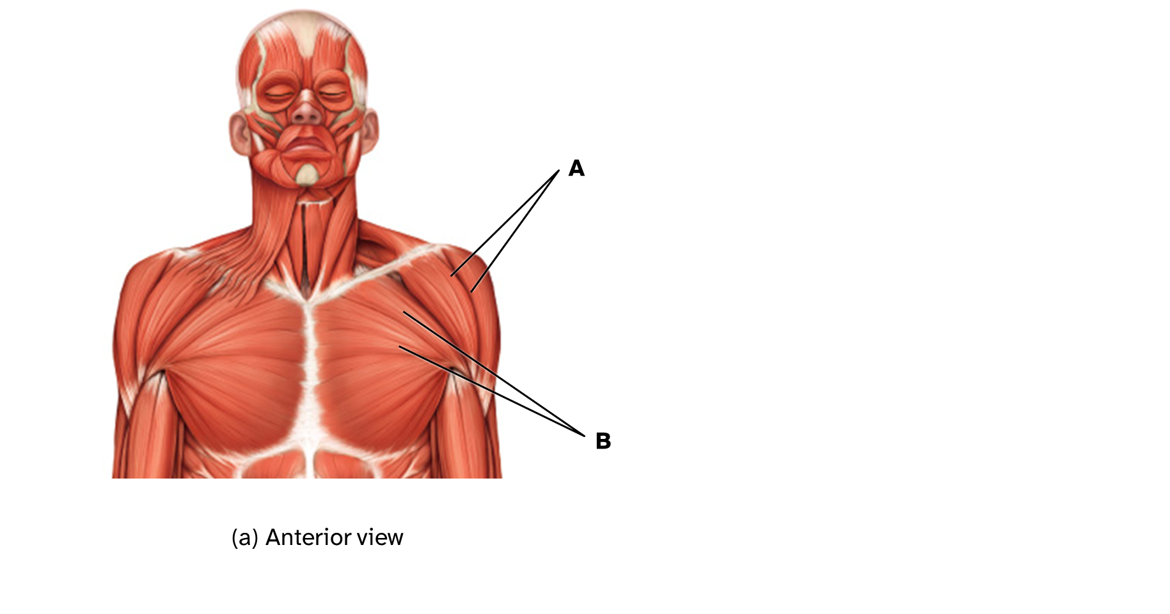
A
B
(a) Anterior view

Slide 20
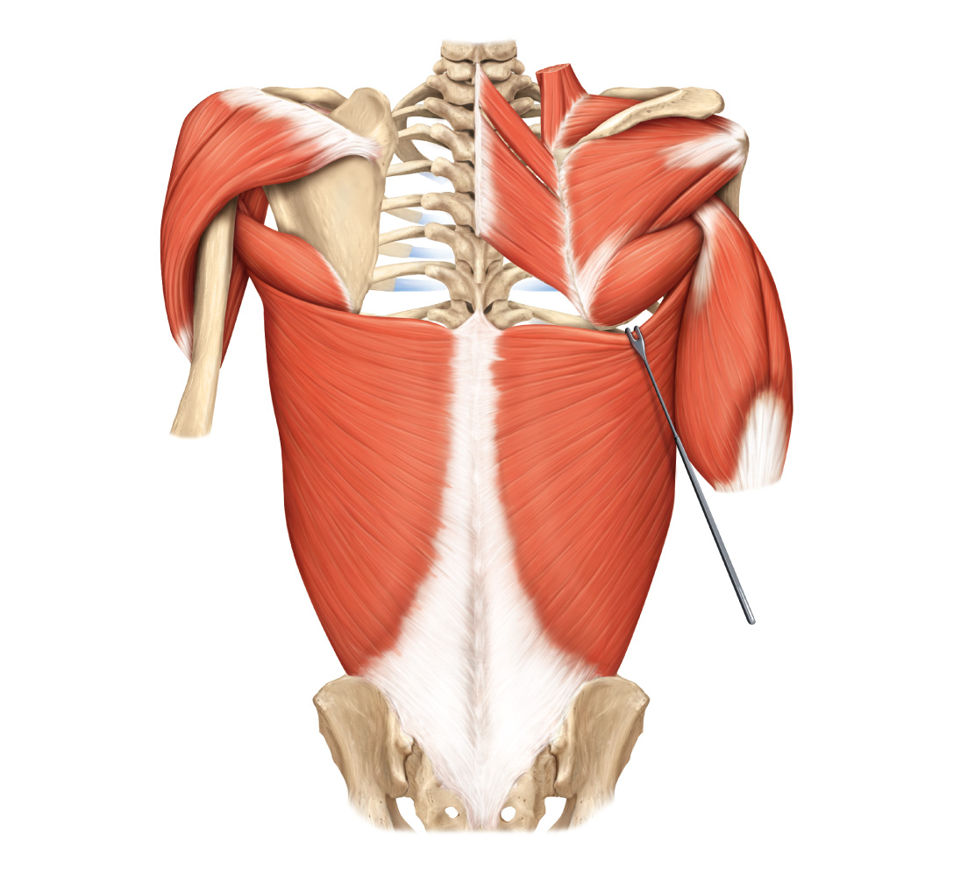
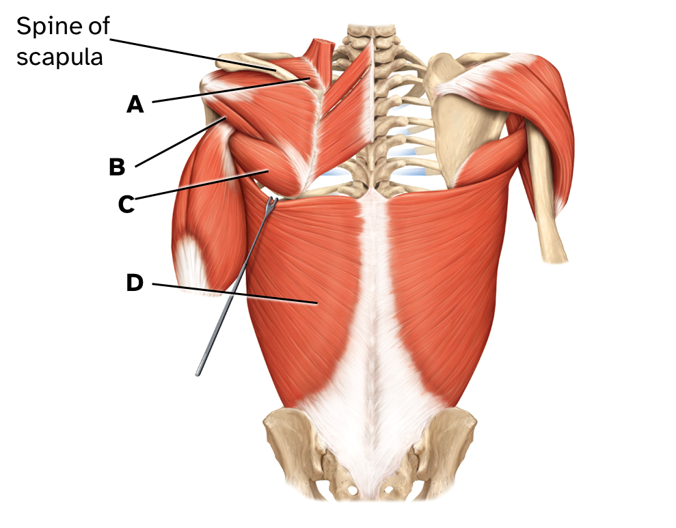
Spine of scapula
A
B
C
D

Slide 21
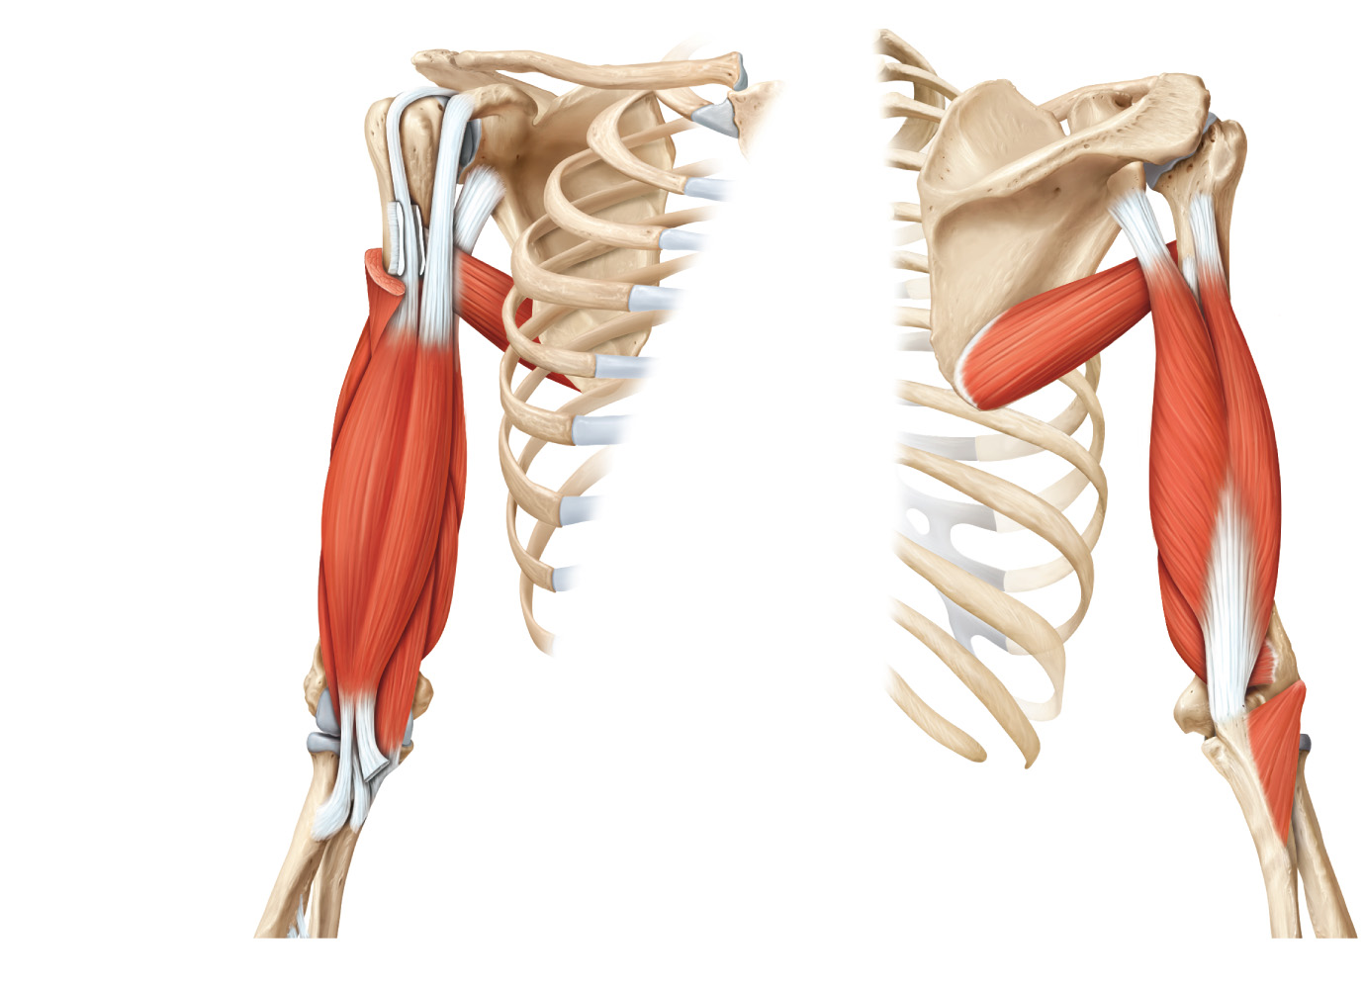
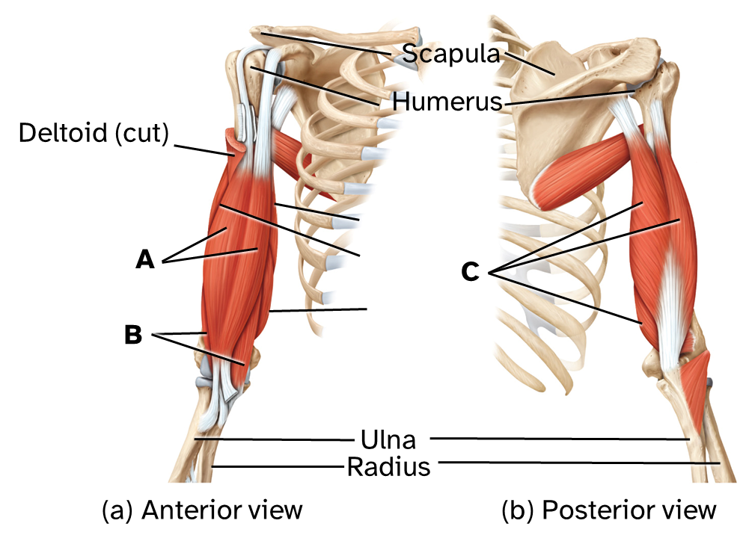
Scapula
Humerus
Deltoid (cut)
A
C
B
Ulna
Radius
(a) Anterior view
(b) Posterior view

Slide 22
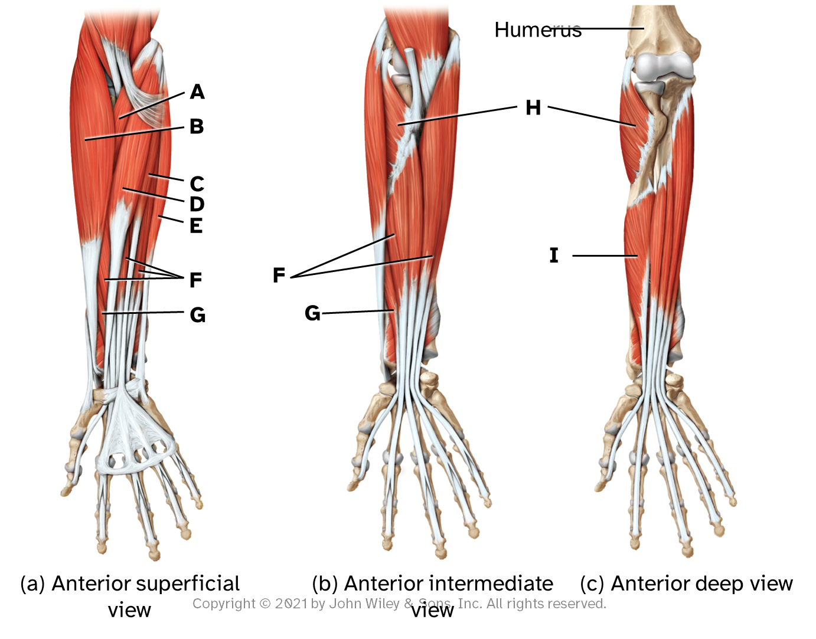
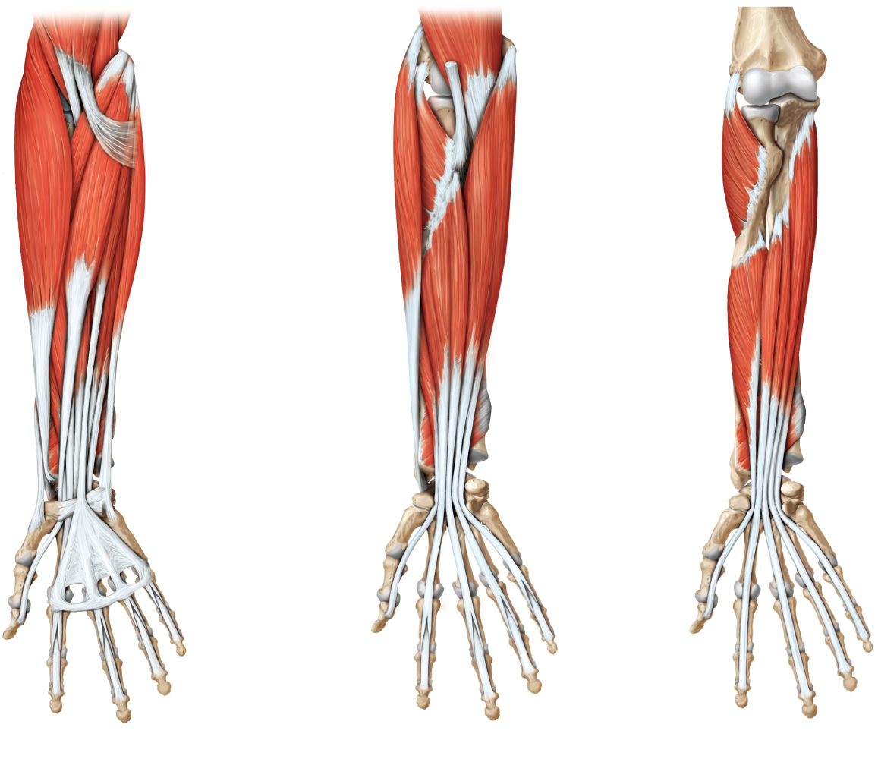
Humerus
A
H
B
C
D
E
I
F
F
G
G
(a) Anterior superficial view
(b) Anterior intermediate view
(c) Anterior deep view

Slide 23
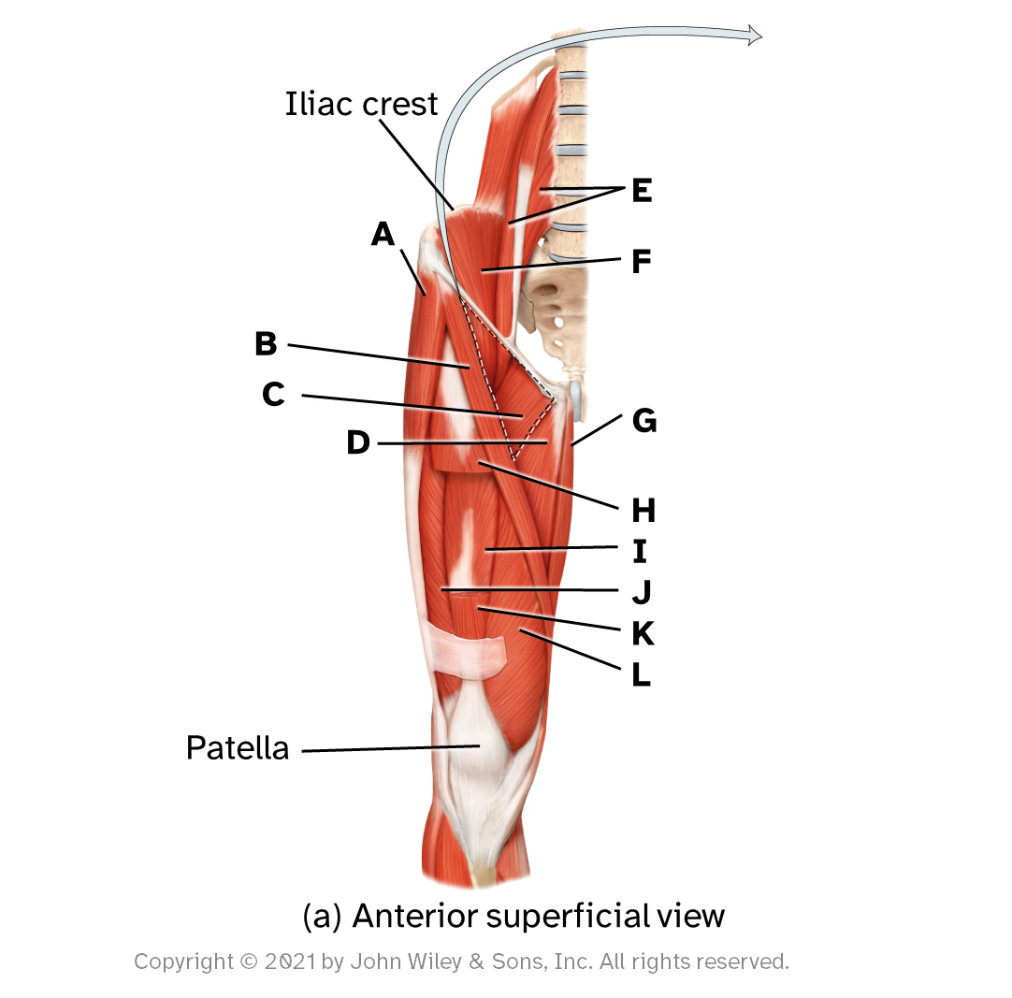
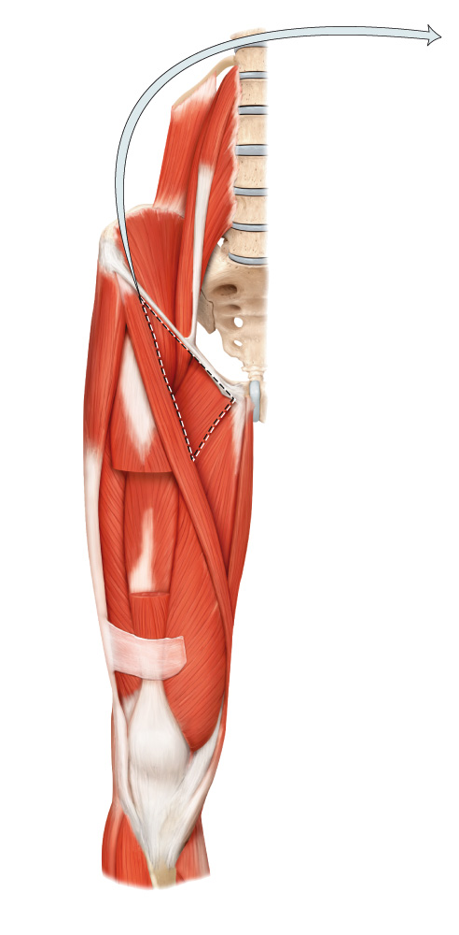
Iliac crest
E
A
F
B
C
G
D
H
I
J
K
L
Patella
(a) Anterior superficial view

Slide 24


Femur
A
B
C
C
E
D
D
Calcaneal tendon (cut in posterior deep view)
(c) Posterior superficial view
(d) Posterior deep view

